Slide 1
Drive with Meeder
Created for: Primerica
Notes:
Hello. I am ________ of Meeder Investment Management. I feel very fortunate to have the opportunity to share information with you about our company and our mutual fund asset allocation portfolios. Additionally, I will review with you our investment process that we believe can provide you and your clients a sound route to getting your clients to their investment destination.

Slide 2




FIRM OVERVIEW
MUTUAL FUNDS, INVESTMENT PORTFOLIOS, SEPARATE ACCOUNTS, AND RETIREMENT PLAN SOLUTIONS
OVER
50 YEARS
OF EXPERIENCE
HEADQUARTERED IN
COLUMBUS, OH
OVER
$150 BILLION
IN ASSETS UNDER ADVISEMENT
AS OF 12/31/2023
DEFENSIVE EQUITY STRATEGY (1974)
MUIRFIELD FUND (1988)
TACTICAL FIXED INCOME (1988)
ASSET ALLOCATION PORTFOLIOS (1995)
SEASONED INVESTMENT TEAM
  CFA® Charterholders
  CMTs
  CAIA
  Portfolio
  Managers
  & Analysts
2
Notes:
Since our firm was founded in 1974, we have had to navigate through just about any kind of market environment one could imagine. Along the way we encountered inflationary environments, deflationary environments and even stagflation. We have successfully managed through rising and declining interest-rate environments, two secular BEAR markets, stock market crashes, the bursting of the dot com and real estate bubbles and the 2008 Financial Crisis, also known as the Great Recession. Throughout the 50 years, we have been based in Columbus Ohio and developed our own family of mutual funds, asset allocation portfolios, separate accounts and a variety of retirement plan solutions. Today, we are responsible for overseeing $150 billion in assets under advisement.
The first portfolios we provided investors in 1974 employed our Defensive Equity Strategy, which in today's terms would be called a tactical investment strategy. The Defensive Equity Strategy attempts to identify the risk/reward relationship that exist in the financial markets and then allocates the portfolio’s assets accordingly. In addition to incorporating the Defensive Equity Strategy in our portfolios, in 1988, we launched our flagship fund, the Meeder Muirfield Fund, based entirely on this strategy.
We have been managing asset allocation portfolios since the mid-90s and we have a deep and seasoned investment team.
The team includes:
CFA Charterholders, Chartered Market Technicians, Chartered Alternative Investment Analysts and a number of portfolio managers and analysts that are dedicated to the management of our clients’ assets.

Slide 3
We are dedicated to improving investor outcomes by keeping clients committed to their investment strategy throughout a full market cycle.
3
Notes:
This statement is the key to everything that we do at Meeder.
(Read slide)
So how do we do this?

Slide 4

How we do it
Meeder Investment Positioning System (IPS)
—a multi-discipline/multi-factor approach
4
Notes:
We utilize the Meeder Investment Positioning System or IPS, which is a multi-discipline/multi-factor approach to investing. We want to help investors keep emotion out of the decision making process.

Slide 5





IPS EVALUATES THE
CURRENT ENVIRONMENT
QUANTITATIVE RISK/REWARD ANALYSIS
CLEAR
RAIN
FOG
SNOW
BLIZZARD
RISK / RETURN POTENTIAL
5

Slide 6




REWARD vs RISK
90−100%
EQUITY EXPOSURE
6
Notes:
Let’s use an illustration. Take a look at this road. Its completely clear and appears to be a low risk environment for driving. How comfortable would you feel going the speed limit? Chances are high that you would probably feel comfortable driving at or near the speed limit. From an investment perspective, if our model tells us that we are in this kind of condition, we will likely be 90+% invested in the stock market. Again, remember that this is the green portion of the portfolio.

Slide 7

REWARD vs RISK
70−90%
EQUITY EXPOSURE
7
Notes:
When you have a slight bend in the road where you can’t tell what is around the corner, you would likely exercise a little caution. If our model tells us that we should exercise a some caution…. In this scenario, we will likely be roughly 70-90% invested.

Slide 8

REWARD vs RISK
50−70%
EQUITY EXPOSURE
8
Notes:
If the conditions were to progressively worsen, we would reduce our equity exposure further. In this example we would likely maintain roughly 50-70% equity exposure.

Slide 9

REWARD vs RISK
25−50%
EQUITY EXPOSURE
9
Notes:
If there were a situation that would require us to exercise further caution, we would reduce our equity exposure between 25-50%.

Slide 10

REWARD vs RISK
0−25%
EQUITY EXPOSURE
10
Notes:
And finally, if we were to experience an extreme situation in the marketplace that would equate to this type of weather environment, we have the flexibility to continue to reduce our equity exposure further, which could include eliminating all equity exposure in the stock market.

Slide 11
Lifetime Investment Models
HIGHER
GROWTH STRATEGY
This is a constrained tactical strategy that can shift exposure primarily among securities, including sector over and underweights, international securities, and market capitalization ranges.
DEFENSIVE EQUITY STRATEGY
This is an unconstrained tactical strategy that can shift from equity securities to cash or fixed income securities when the risk/reward relationship of the stock market is deemed unfavorable.
FIXED INCOME STRATEGY
This is a strategy that can shift between U.S. government and agency securities, investment-grade bonds, high-yield corporate bonds, and international debt. It also incorporates duration management to maneuver between short or long duration positions.
DYNAMIC GROWTH PORTFOLIO
100% Growth Strategy
GROWTH PORTFOLIO
100% Defensive Equity Strategy
RISK / RETURN POTENTIAL
MODERATE GROWTH PORTFOLIO
70% Defensive Equity Strategy
30% Fixed Income Strategy
CONSERVATIVE GROWTH PORTFOLIO
50% Defensive Equity Strategy
50% Fixed Income Strategy
LOWER
CONSERVATIVE PORTFOLIO
30% Defensive Equity Strategy
70% Fixed Income Strategy
11
Notes:
Our mutual funds make up the Defensive Equity and Fixed Income Strategy. As you can see, our risk based portfolios have different amounts of exposure to each of these strategies to match different risk profiles. The portion of the portfolio that we will begin talking about is our Defensive Equity Strategy. This is the green portion of the portfolio. This is an unconstrained tactical strategy that can shift from equity securities to cash or fixed income securities when the risk/reward relationship of the stock market is deemed unfavorable.

Slide 12
Lifetime Investment Models
FOR EXAMPLE: IF OUR IPS INDICATES
    50% EQUITY EXPOSURE...
GROWTH PORTFOLIO
100% Defensive Equity Strategy
GROWTH PORTFOLIO
50% Equities
50% Defensive*
GROWTH PORTFOLIO
100% Defensive Equity Strategy
MODERATE GROWTH PORTFOLIO
70% Defensive Equity Strategy
30% Fixed Income Strategy
MODERATE GROWTH PORTFOLIO
70% Defensive Equity Strategy
30% Fixed Income Strategy
MODERATE GROWTH PORTFOLIO
35% Equities
35% Defensive*
30% Fixed Income Strategy
CONSERVATIVE GROWTH PORTFOLIO
50% Defensive Equity Strategy
50% Fixed Income Strategy
CONSERVATIVE GROWTH PORTFOLIO
25% Equities
25% Defensive*
50% Fixed Income Strategy
CONSERVATIVE GROWTH PORTFOLIO
50% Defensive Equity Strategy
50% Fixed Income Strategy
CONSERVATIVE PORTFOLIO
30% Defensive Equity Strategy
70% Fixed Income Strategy
CONSERVATIVE PORTFOLIO
30% Defensive Equity Strategy
70% Fixed Income Strategy
CONSERVATIVE PORTFOLIO
15% Equities
15% Defensive*
70% Fixed Income Strategy
*Defensive allocations could include cash or equivalents, fixed income securities or funds, and/or short sales of stock index futures.
12
Notes:
So let’s go through a brief example of how this would work. If our Investment Positioning System commonly known as or IPS, indicates that the Defensive Equity portion of our portfolios should be 50% defensive. This is how it would impact each of the portfolios.

Slide 13
We are dedicated to improving investor outcomes by keeping clients committed to their investment strategy throughout a full market cycle.
13
Notes:
This statement is the key to everything that we do at Meeder.
(Read slide)
So how do we do this?

Slide 14

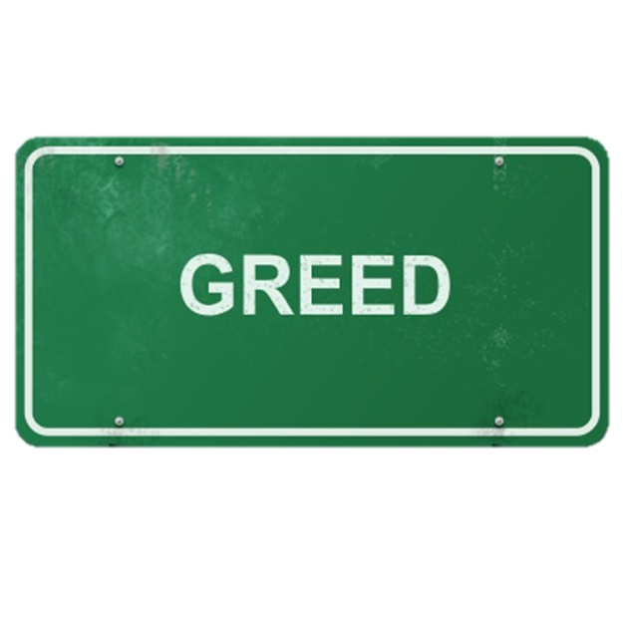


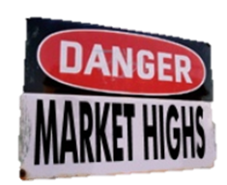
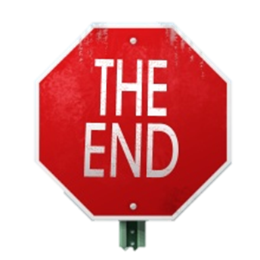
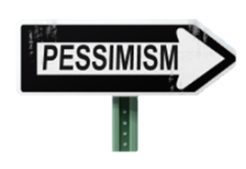
14
Notes:
Meeder strategies are built with real-world behavior in mind. They are not based on what investors should do or what they could do, but what they actually do. We want to keep investors committed to their outcomes by attempting to remove the emotion from the investment process by using data, throughout a full market cycle. We believe that if investors do this, they will not get sidetracked by all of the emotions that can keep them from reaching their investment goals.

Slide 15
Disclosure
The views expressed herein are exclusively those of Meeder Investment Management, Inc., are not offered as investment advice, and should not be construed as a recommendation regarding the suitability of any investment product or strategy for an individual’s particular needs. Investment in securities entails risk, including loss of principal. Asset allocation and diversification do not assure a profit or protect against loss. There can be no assurance that any investment strategy will achieve its objectives, generate positive returns, or avoid losses.
Commentary offered for informational and educational purposes only. Opinions and forecasts regarding markets, securities, products, portfolios, or holdings are given as of the date provided and are subject to change at any time. No offer to sell, solicitation, or recommendation of any security or investment product is intended. Certain information and data has been supplied by unaffiliated third parties as indicated. Although Meeder believes the information is reliable, it cannot warrant the accuracy, timeliness or suitability of the information or materials offered by third parties.
The portfolios may not be suitable for all investors. Asset allocation and diversification do not assure a profit or protect against loss. All investments carry a certain amount of risk and there is no guarantee that any strategy will its objectives, generate positive returns, or avoid losses. Meeder does not provide tax advice and does not represent that any portfolio design will result in a particular tax consequence. This material is provided for informational and educational purposes only and does not constitute a recommendation or investment advice regarding the suitability of any portfolio for any circumstances. Investment advisory services offered by Meeder Advisory Services, Inc.
Meeder Investment Management provides products by contractual relationship with PFS Investments, Inc. (PFSI), a subsidiary of Primerica Inc. PFSI's advisory business operates under the trade name Primerica Advisors and offers the wrap fee program, Primerica Advisors Lifetime Investment Program™. Meeder Investment Management is not affiliated with Primerica Inc. or PFSI.
Investment advisory services provided by Meeder Asset Management, Inc.
Meeder Investment Management
6125 Memorial Drive
©2023 Meeder Investment Management, Inc.
Meeder Investment Management
6125 Memorial Drive
Dublin, OH 43017
Phone: 866.633.3371
meederinvestment.com
0050-MAM-4/23/2024
Primerica

